Slide 2
Correct Vs wrong(SL_b)
Drift rate different since ‘evidence on’
After response amplitude drops faster
Lowest at response time
(from scalp plots) correct have clearer CPP burst around 300-900 than wrong
(from scalp plots) same amplitude; but correct CPP moves more to centre from 300-900
Notes:
EEG_sorting_plot_SL_b.m

Slide 3
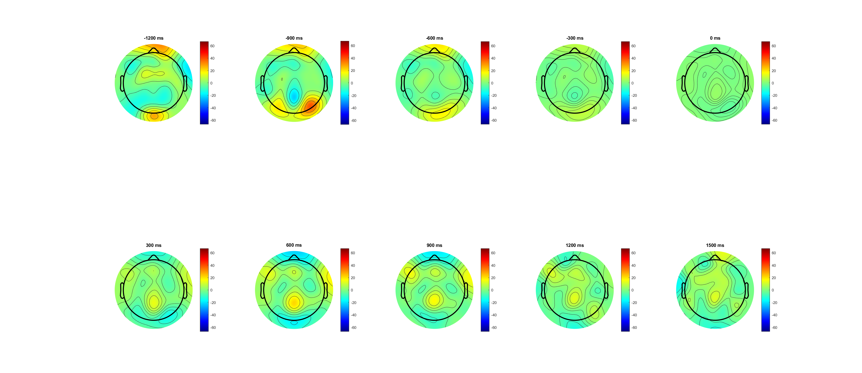
correct

Slide 4
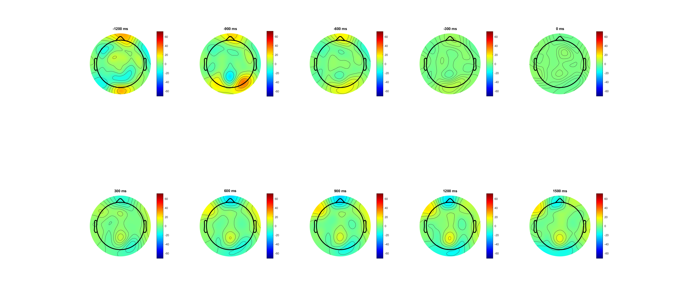
Wrong

Slide 5
FDI Vs BCP(SL_b)
Drift rate different since ‘evidence on’
After response amplitude drops faster
Lowest at response time (only FDI)
(from scalp plots) correct have clearer CPP burst around 300-900 than wrong
(from scalp plots) same amplitude; but correct CPP moves more to centre from 300-900
Notes:
EEG_sorting_plot_SL_b.m

Slide 6
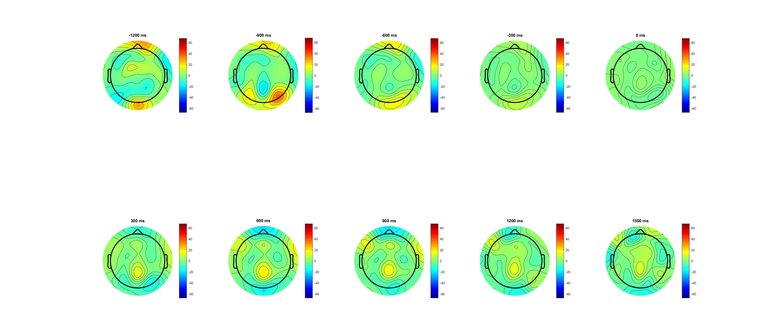
FDI

Slide 7
BCP

